Slide 1



Prediction Model For Resource Optimization
CloverShield Insurance Predictive Model Competition
Date:11/20/2024

Slide 2
BUSINESS PROBLEM
Data Mining Process
Goal
Business Goal
Identify Data
Prepare Data
Model & Evaluate Data
Present Data
Optimize resource allocation and enhance cost-efficiency in call center operations in order to reduce call center costs
Present actionable insights and results of model evaluation.
Data Mining
Outcome

Slide 3
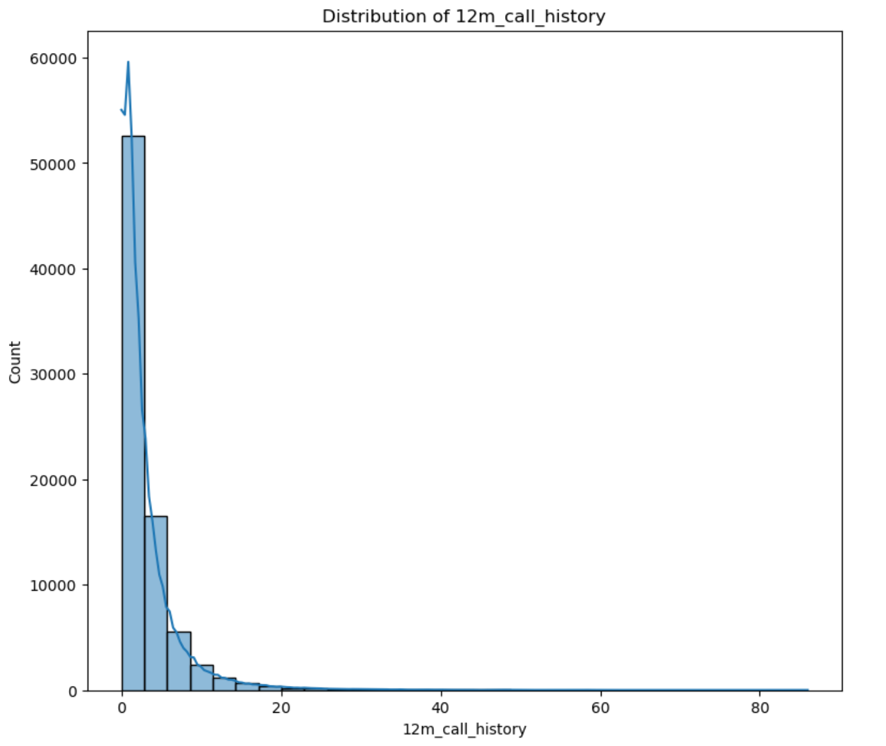
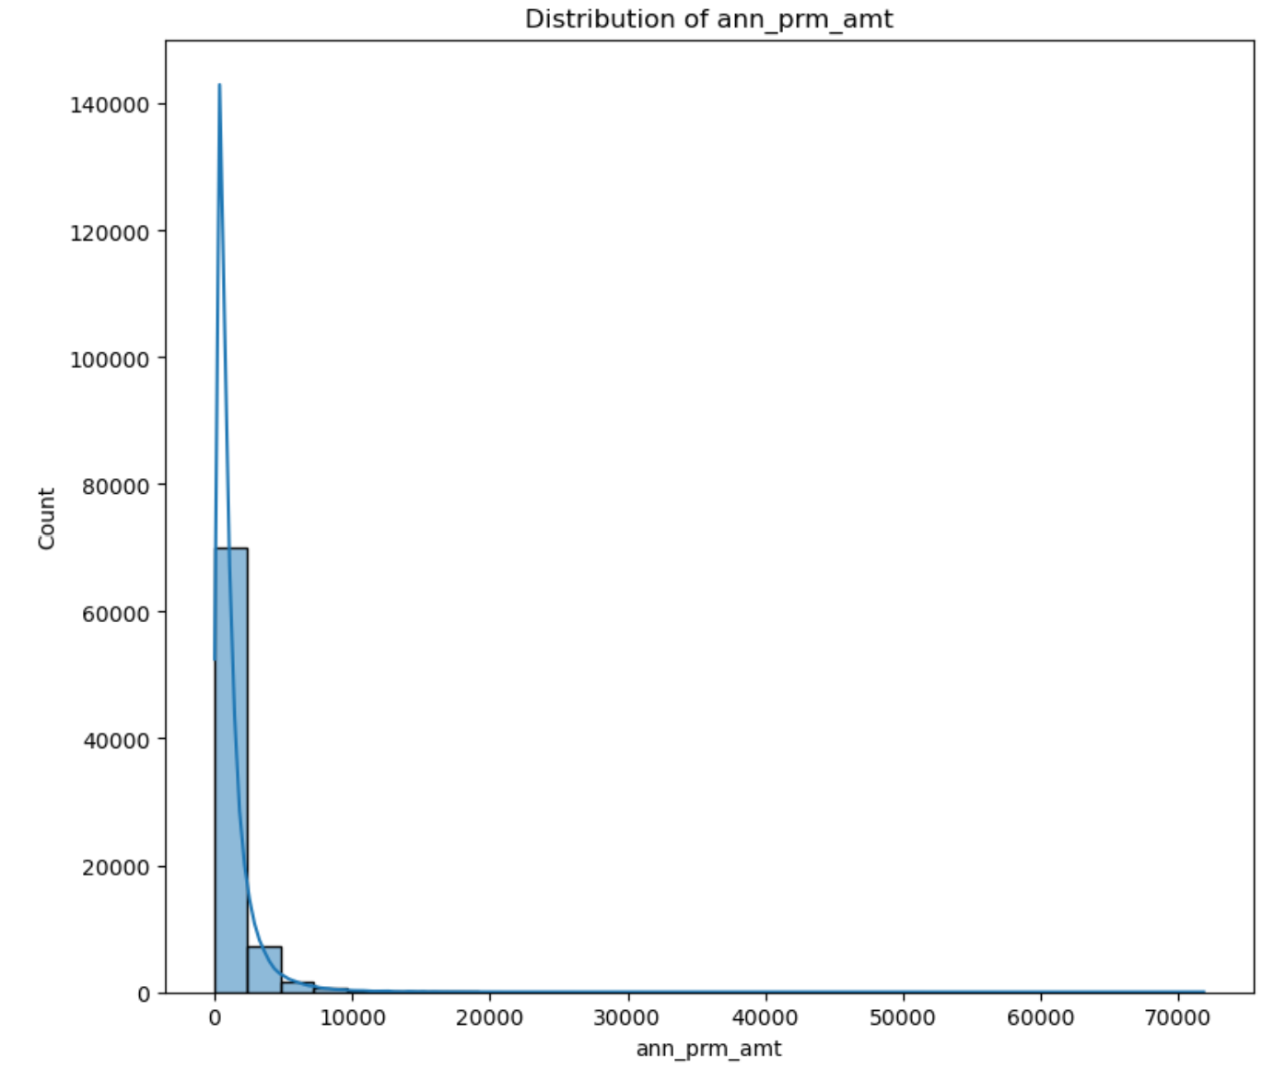
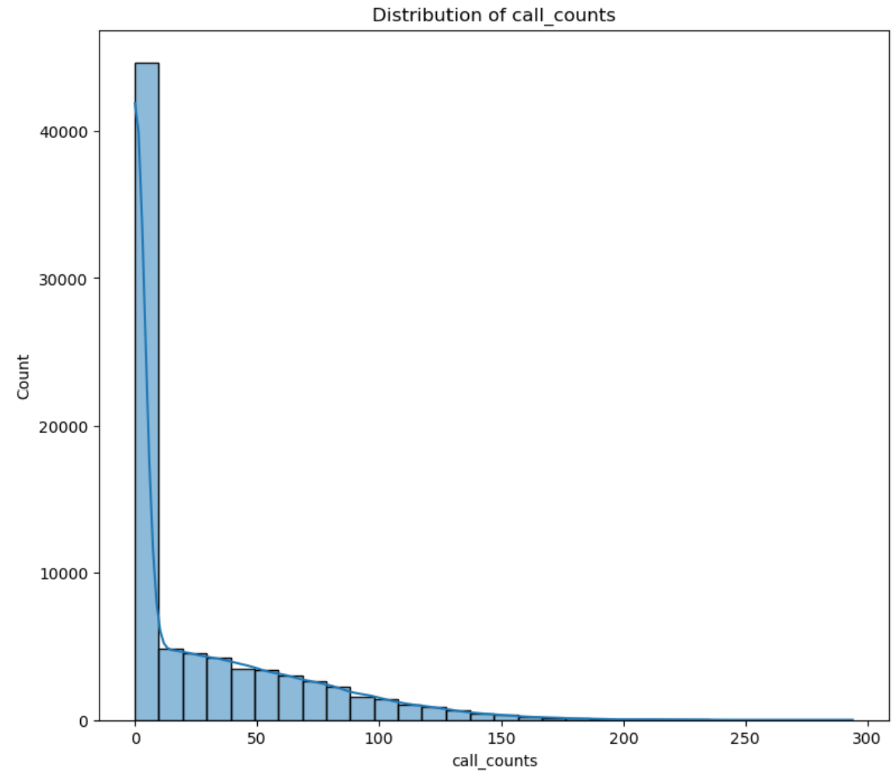
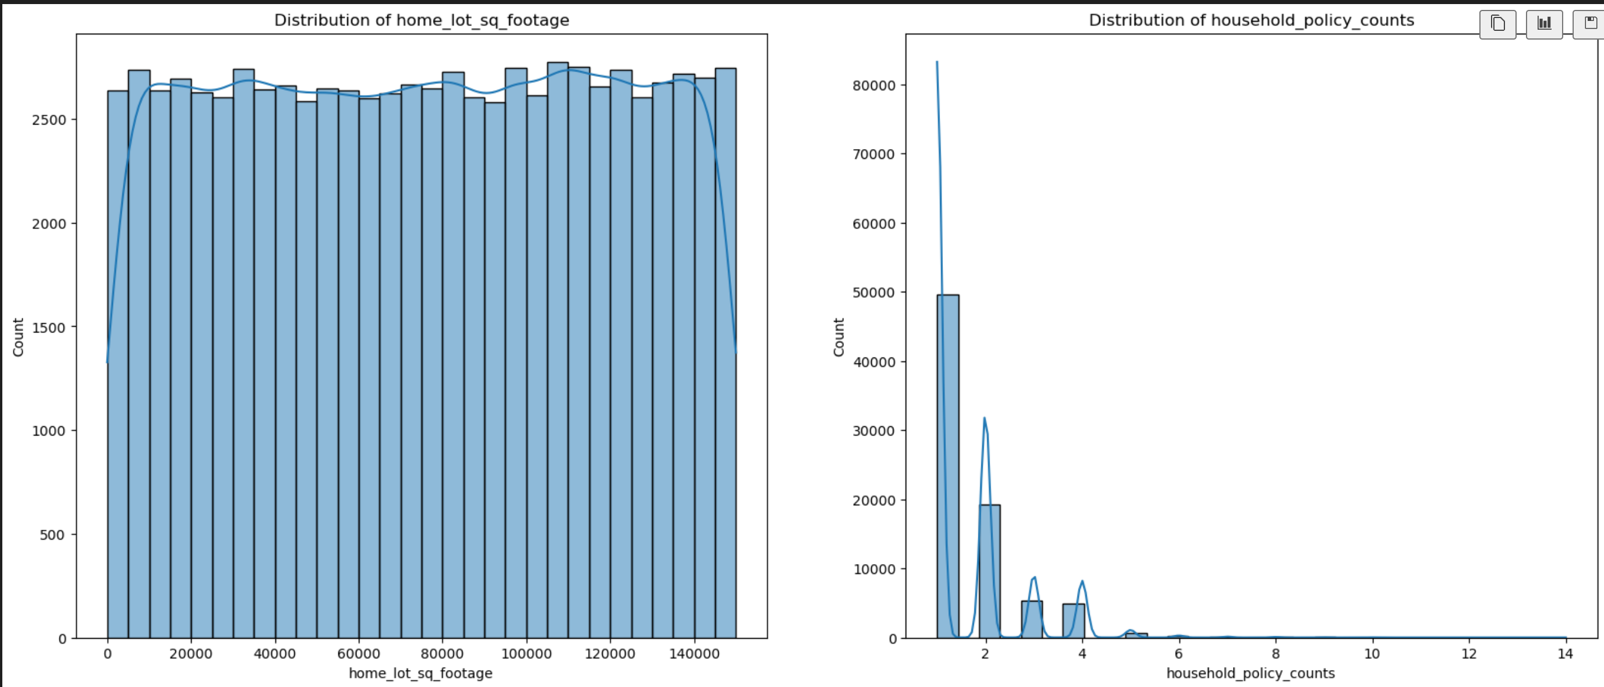
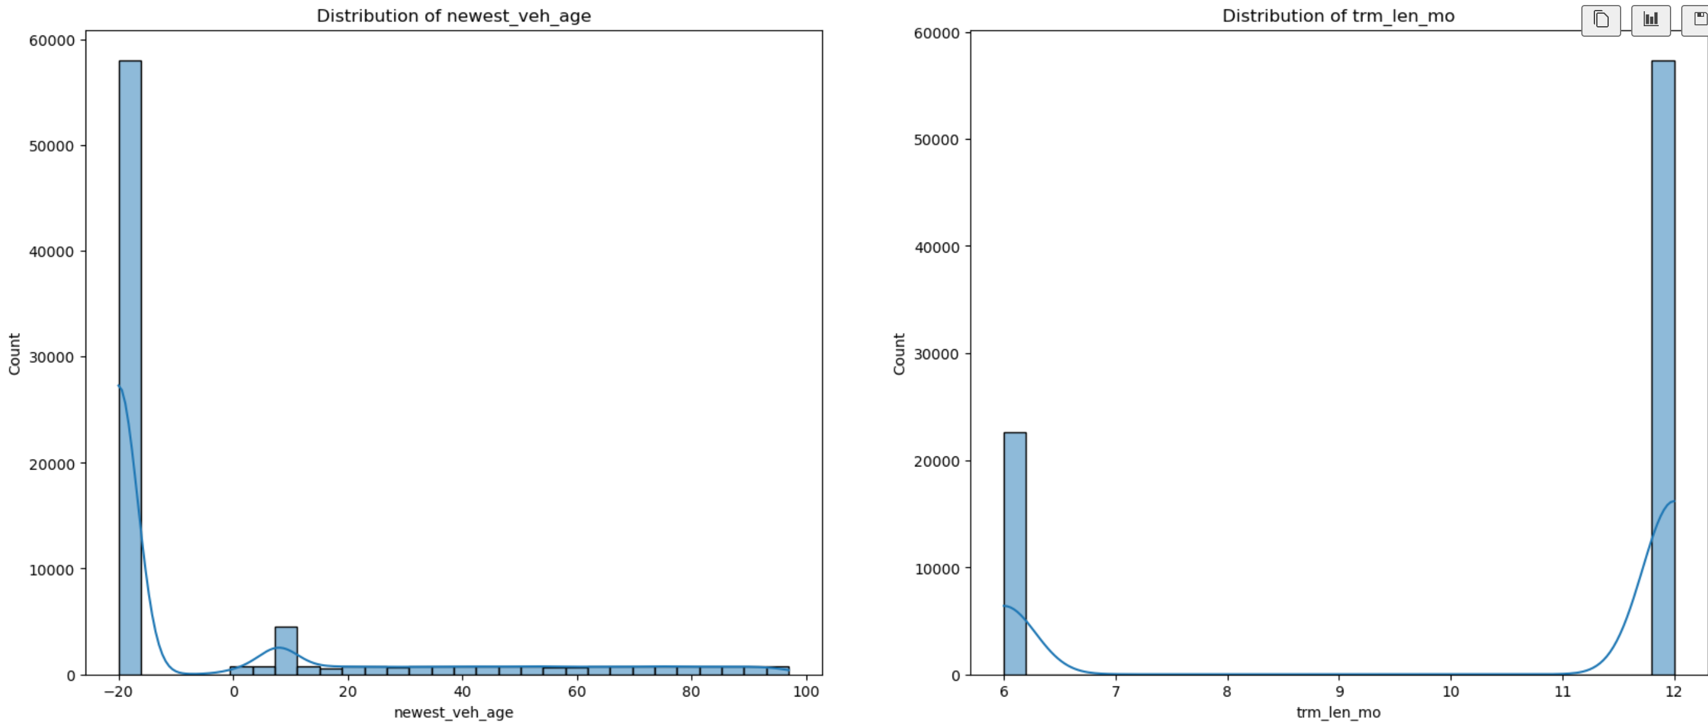
DATA EXPLORATION
DATASET BASIC IMFORMATION
Imbalance target variable distribution

Slide 4
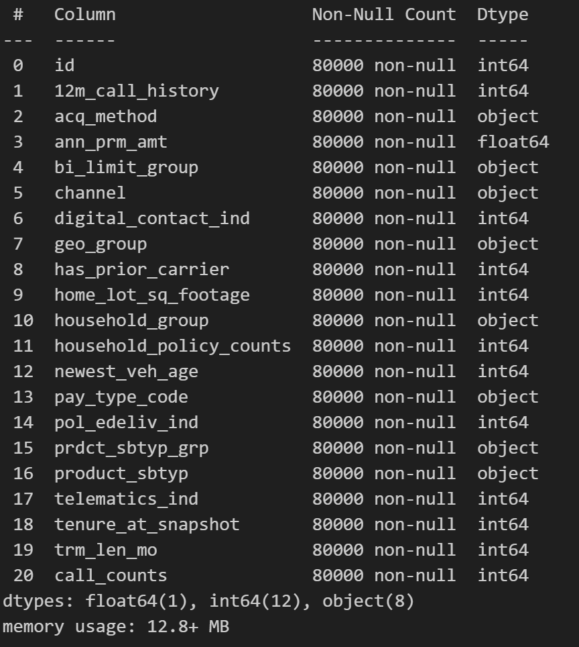
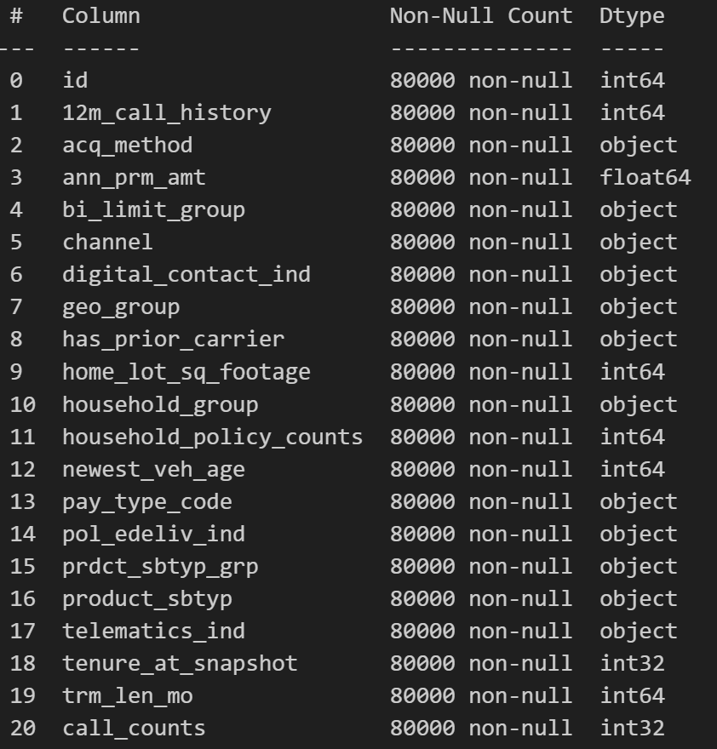
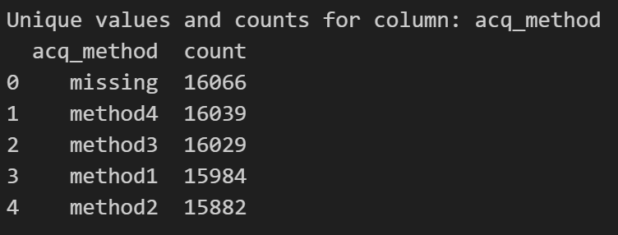
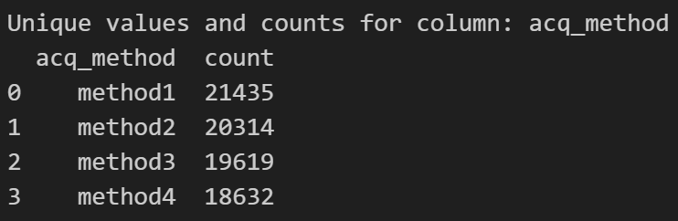
DATA PROCESSING
Data type changing
Object to Int:
Call_counts
Tenure_at_snapshot
Object to Int:
Pol_edeliv_ind
digital_contact_ind
has_prior_carrier
Deal with missing value: Knn method to predict the missing value

Slide 5
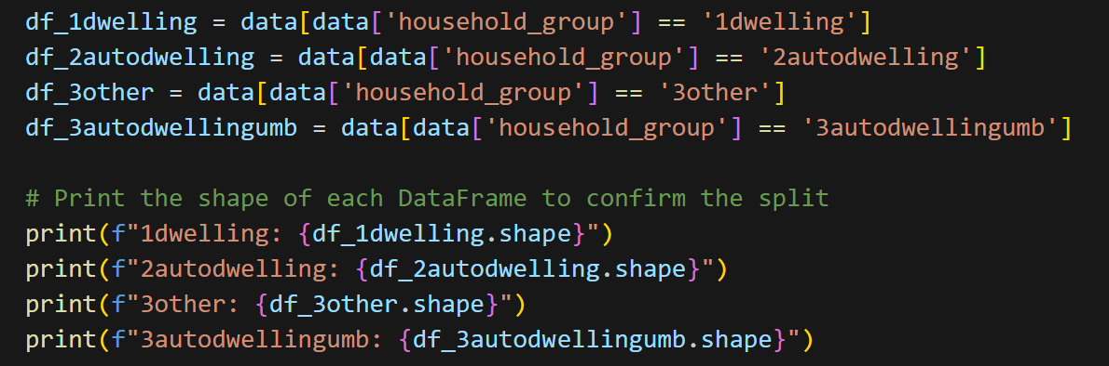
DATA PROCESSING
household_group: The types of policy in household
1dwelling: (49073, 21)
2autodwelling: (20155, 21
)3other: (8942, 21)
3autodwellingumb: (1830, 21)
1dwelling - Non-Auto: (49073, 21), Auto: (0, 21)
2autodwelling - Non-Auto: (0, 21), Auto: (20155, 21)
3other - Non-Auto: (8942, 21), Auto: (0, 21)
3autodwellingumb - Non-Auto: (0, 21), Auto: (1830, 21)
Auto group shape: (21985, 21)
Non-Auto group shape: (58015, 21)

Slide 6

METHODS CONSIDERATION
Evaluated a few models and in the end used the one that had the best overall performance
Random Forest Regressor
Combines multiple decision trees (built on different subsets of the data) through averaging to make predictions.
Limitations: With larger datasets, requires more time. Also lacks more interpretability because of the model structure with multiple decision trees.
Penalizes the absolute sum of coefficients to shrink some to exactly zero, effectively performing automatic feature selection.
Lasso Regression
Limitations: Model assumes all features are linearly related to the target variable and also performs very poorly when there are a lot of non linear relationships
Balances lexibility and interpretability by seprately model predictor’s contribution, provide smooth funtions, captures models non-linear relationships.
Generalized Additive Models
Limitations: require careful selection of smoothing parameters, less effective in capturing interactions between predictors.
Builds trees sequentially, optimizing errors from previous trees. It uses gradient descent to minimize the loss function.
XGBoost
Limitations: Requires more advanced hyperparameter tuning in order to achieve optimal results, which may not be practical, also more complex model to interpret.
Quantile Regression
Capture complex non linear conditional distribution of target variable, useful to analyze tail behavior.
Limitations: requires a lot of resources(cpu) to train. Very prone to overfitting without optimal tuning and regularization.
Highly fiexible of modeling complex and detect patterns that other models miss
Neural Networks
Limitations: focuses more on the percentiles rather than predicting numbers, which is not what we are looking for in this model, and takes longer for larger datasets.

Slide 7
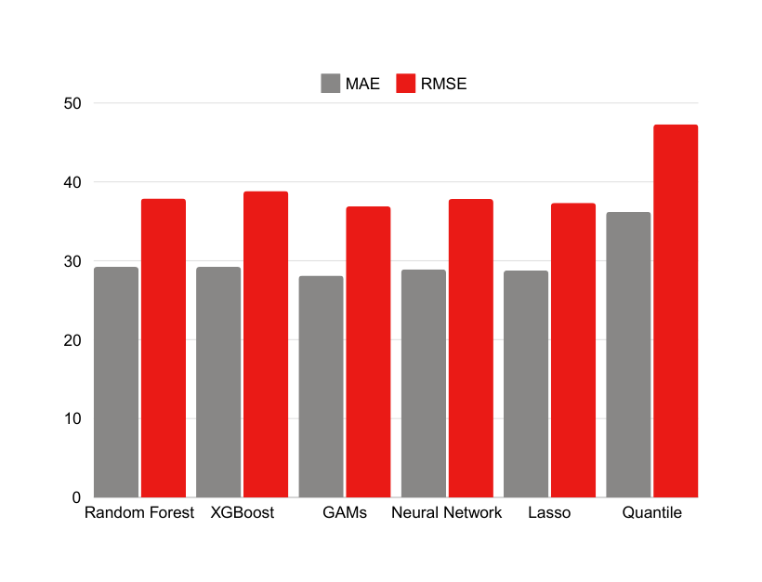
METHODS SELECTION
GAM
Comparison of RMSE:
Random Forest: 37.8815
XGBoost: 38.8416
GAM (Selected): 36.9046
Neural Networks: 37.8316
Lasso Regression: 37.3392
Quantile Regression: 41.8595
Reduces Overfitting
Use smooth functions with regularization, which helps prevent overfitting, especially if the dataset has noise or redundant features.
Data Characteristics
If the dataset has strong but smooth relationships and minimal interaction effects between predictors, GAM is likely to perform better compared to tree-based models, which rely heavily on splits and interactions.
Flexibility in Capturing Non-Linear Relationships
GAM allows for non-linear relationships between individual predictors and the target variable, while maintaining interpretability. This could be crucial if the data exhibits complex but smooth patterns.

Slide 8
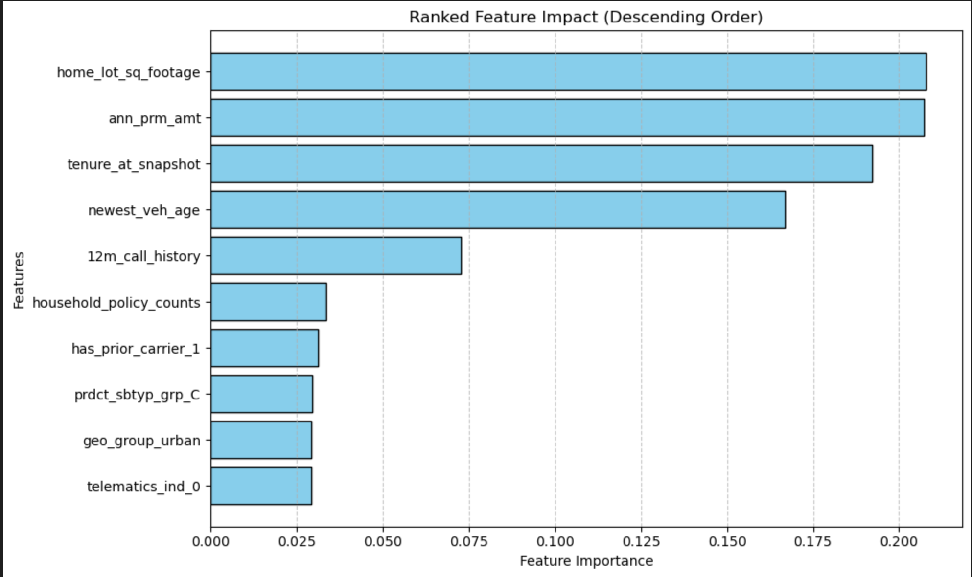
VARIABLE SELECTION
Key Predictors
Home_lot_Sq_footage 12m_call_history
ann_prm_amt
household_policy_counts
tenure_at_snapshot
Feature importance from GAMs for categorical features.
Feature importance from GAMs for continuous features.
Categorical features modeled using dummy variables or as factors. Then the importance of each feature is determined by coefficient magnitudes, significant testing, and model deviance reduction
Continuous features modeled using smooth functions. Then smoothness assessed using the effective degrees of freedom to determine influence as well as model deviance reduction.
Correlation analysis for numerical variables
Create confusion matrix for the numerical variables to evaluate the correlation between them

Slide 9
Demographic variables
Age
More Variables to Consider
Employment Status
Income
Gender
Other variables
There are some more variables that we could add to help improve the model performance, with the data that we had initially it was difficult to find correlations.
Reasons for calling
Location: Specific city, the risk level, Congestion degree
Customer satisfaction level
Unseen variables
External events

Slide 10
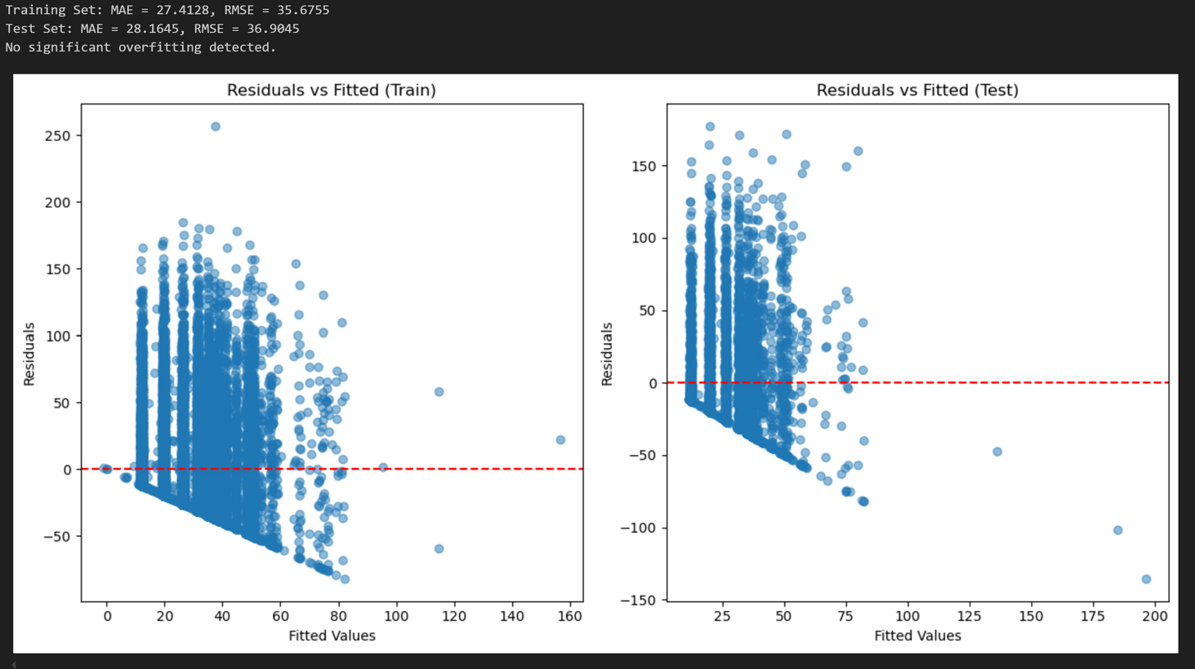
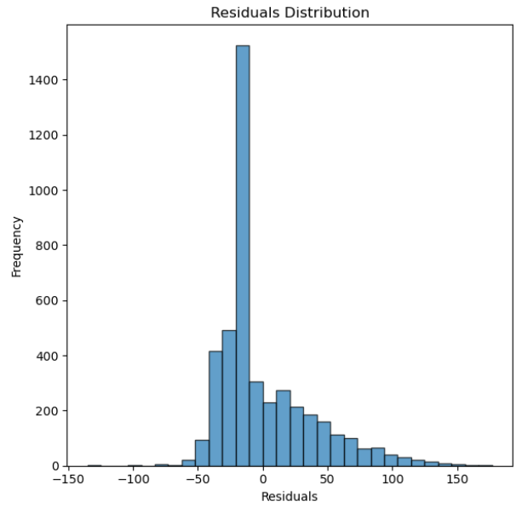
EVALUATING THE MODEL
We evaluated the model by comparing the RMSE of the test data and then the training data to see if there was overfitting. And plot the residual distribution which shows a symmetrical around zero.
According to the code and the result:
Training Set:
MAE = 27.4128, RMSE = 35.6755
Test Set:
MAE = 28.1645, RMSE = 36.9045
No significant overfitting detected.

Slide 11
Potential Improvements
After evaluating the model and generating the predictions, we realized that there is still a lot of room for improvement, ex: R² is very low, and here are some ways that we could potentially improve the overall result.
Improving the data
Explore more with feature engineering
Explore alternative modeling methods
When performing data processing, we found that more than half the datapoints are non-auto, which added confusion when separating the data. Additionally, when try to see the correlation matrix, each variable had a very low correlation.
Even though we did conduct some feature engineering, there is still a lot of error. We could have done some more exploring relationships between the features in order to create some more meaningful features
We went through 6 modeling methods to create the predictive model, there are probably still many more that could potentially yield better results.

Slide 12


Thank You!
Any questions?
wztsai@emory.edu
Cynthia.kong@emory.edu

